Slide 1
Research Methodology and Intellectual Property Rights Unit - I

Slide 2
RESEARCH
Research is a process of systematic inquiry that entails collection of data; documentation of critical information; and analysis and interpretation of that data/information, in accordance with suitable methodologies set by specific professional fields and academic disciplines.

Slide 3
RESEARCH
The Advanced Learner’s Dictionary of Current English - meaning of research as
“a careful investigation or inquiry specially through search for new facts in any branch of knowledge”
According to Clifford Woody research comprises
defining and redefining problems,
Formulating hypothesis or suggested solutions;
collecting, organizing and evaluating data;
making deductions and reaching conclusions;
carefully testing the conclusions to determine whether they fit the formulating hypothesis.

Slide 4
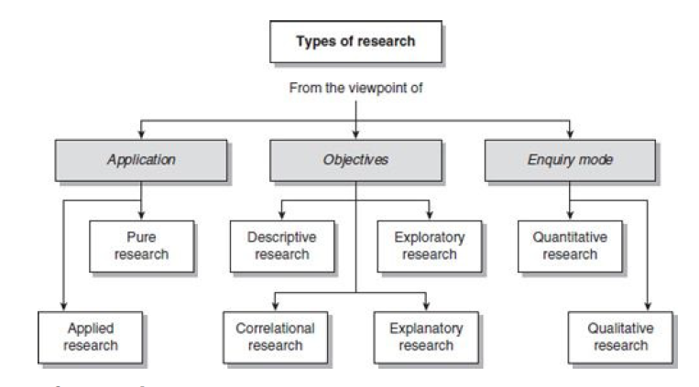

Slide 5
TYPES OF RESEARCH
Descriptive vs. Analytical
Descriptive
surveys and fact-finding enquiries
description of the state of affairs as it exists at present
Ex post facto research
the researcher has no control over the variables; he can only report what has happened or what is happening
discover causes even when they cannot control the variables
Analytical
use facts or information already available, and analyze these to make a critical evaluation of the material

Slide 6
TYPES OF RESEARCH
Applied vs. Fundamental
Applied
finding a solution for an immediate problem facing a society or an industrial/business organization
to identify social, economic or political trends that may affect a particular institution
Fundamental
generalizations and formulation of a theory
Pure mathematics
concerning human behavior carried on with a view to make generalizations about human behavior, are also examples of fundamental research

Slide 7
TYPES OF RESEARCH
Quantitative vs. Qualitative
Quantitive
based on the measurement of quantity or amount
applicable to phenomena that can be expressed in terms of quantity
Qualitative
phenomena relating to or involving quality or kind
investigating the reasons for human behavior (i.e., why people think or do certain things), - ‘Motivation Research’
aims at discovering the underlying motives and desires, using in depth interviews, word association tests, sentence completion tests, story completion tests and similar other projective techniques
Attitude or opinion research
discover the underlying motives of human behavior
while doing such research, one should seek guidance from experimental psychologists

Slide 8
TYPES OF RESEARCH
Conceptual vs. Empirical
Conceptual
related to some abstract idea(s) or theory
used by philosophers and thinkers to develop new concepts or to reinterpret existing ones
Empirical
relies on experience or observation alone, often without due regard for system and theory
data-based research
coming up with conclusions which are capable of being verified by observation or experiment
experimental type of research

Slide 9
CRITERIA OF GOOD RESEARCH
The purpose of the research should be clearly defined and common concepts be used
The research procedure used should be described in sufficient detail to permit another researcher to repeat the research for further advancement, keeping the continuity of what has already been attained
The procedural design of the research should be carefully planned to yield results that are as objective as possible

Slide 10
CRITERIA OF GOOD RESEARCH
The researcher should report with complete frankness, flaws in procedural design and estimate their effects upon the findings
The analysis of data should be sufficiently adequate to reveal its significance and the methods of analysis used should be appropriate. The validity and reliability of the data should be checked carefully
Conclusions should be confined to those justified by the data of the research and limited to those for which the data provide an adequate basis
Greater confidence in research is warranted if the researcher is experienced, has a good reputation in research and is a person of integrity

Slide 11
QUALITIES OF A GOOD RESEARCH
Good research is systematic
Good research is logical
Good research is empirical
Good research is replicable

Slide 12
OBJECTIVES OF RESEARCH
To gain familiarity with a phenomenon or to achieve new insights into it (studies with this object in view are termed as exploratory or formulative research studies);
investigating a problem that has not been studied or thoroughly investigated in the past
to have a better understanding of the existing problem, but usually doesn't lead to a conclusive result
E.g. To conduct a product research – before or after development – adding a new feature to an app

Slide 13
OBJECTIVES OF RESEARCH
To portray accurately the characteristics of a particular individual, situation or a group (studies with this object in view are known as descriptive research studies);
useful when conducting research whose aim is to identify characteristics, frequencies, trends, correlations, and categories
takes a problem with little to no relevant information and gives it a befitting description using qualitative and quantitative research methods.
Descriptive research aims to accurately describe a research problem
Surveys, comparing student performance

Slide 14
OBJECTIVES OF RESEARCH
To determine the frequency with which something occurs or with which it is associated with something else (studies with this object in view are known as diagnostic research studies);
To test a hypothesis of a causal relationship between variables (such studies are known as hypothesis-testing research studies)

Slide 15
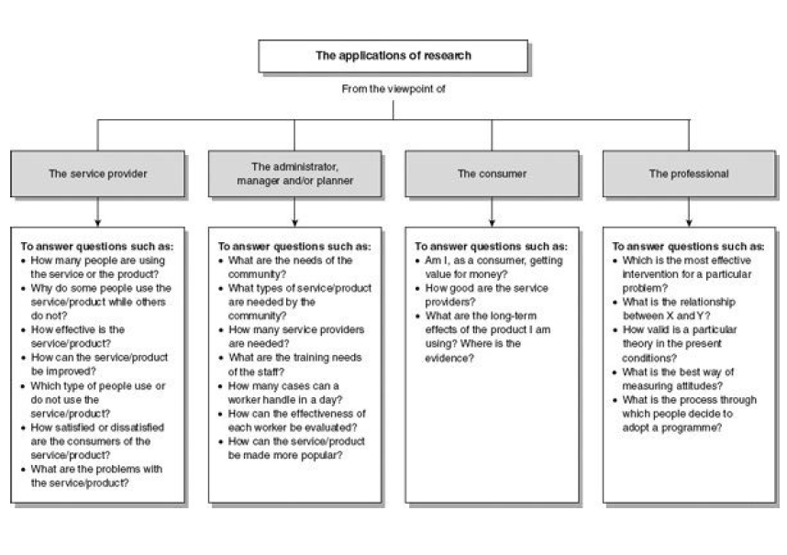

Slide 16
MOTIVATION IN RESEARCH
Desire to get a research degree along with its consequential benefits;
Desire to face the challenge in solving the unsolved problems, i.e., concern over practical problems initiates research;
Desire to get intellectual joy of doing some creative work;
Desire to be of service to society;
Desire to get respectability.

Slide 17
WHAT IS A RESEARCH PROBLEM?
Some difficulty which a researcher experiences in the context of either a theoretical or practical situation and wants to obtain a solution for the same
An individual or a group of persons can be said to have a problem which can be technically described as a research problem,
if they (individual or the group), having one or more desired outcomes,
are confronted with two or more courses of action that have some but not equal efficiency for the desired objective(s)
and are in doubt about which course of action is best
Pb(O1| I , C1, N) not the same as Pb(O1| I , C2 , N)

Slide 18
Components of a research problem
There must be an individual or a group which has some difficulty or the problem.
There must be some objective to be attained at. If one wants nothing, one cannot have a problem.
There must be alternative means (or the courses of action) for obtaining the objective one wishes to attain. This means that there must be at least two means available to a researcher for if he has no choice of means, he cannot have a problem.

Slide 19
Components of a research problem
There must remain some doubt in the mind of a researcher with regard to the selection of alternatives.
This means that research must answer the question concerning the relative efficiency of the possible alternatives.
There must be some environment(s) to which the difficulty pertains.

Slide 20
SELECTING THE PROBLEM
Must be carefully selected
Help may be taken from a research guide in this connection
Nevertheless, every researcher must find out his own salvation for research problems
Subject which is overdone should not be normally chosen, for it will be a difficult task to throw any new light in such a case.
Controversial subject should not become the choice of an average researcher.
Too narrow or too vague problems should be avoided.

Slide 21
SELECTING THE PROBLEM
The subject selected for research should be familiar and feasible so that the related research material or sources of research are within one’s reach.
Even then it is quite difficult to supply definitive ideas concerning how a researcher should obtain ideas for his research.
For this purpose, a researcher should contact an expert who is already engaged in research.
He may as well read articles published in current literature available on the subject and may think how the techniques and ideas discussed therein might be applied to the solution of other problems.
He may discuss with others what he has in mind concerning a problem. In this way he should make all possible efforts in selecting a problem.

Slide 22
SELECTING THE PROBLEM
The importance of the subject, the qualifications and the training of a researcher, the costs involved, the time factor are few other criteria that must also be considered in selecting a problem.
In other words, before the final selection of a problem is done, a researcher must ask himself the following questions:
Whether he is well equipped in terms of his background to carry out the research?
Whether the study falls within the budget he can afford?
Whether the necessary cooperation can be obtained from those who must participate in research as subjects?
If the answers to all these questions are in the affirmative, one may become sure so far as the practicability of the study is concerned.

Slide 23
SELECTING THE PROBLEM
The selection of a problem must be preceded by a preliminary study.
This may not be necessary when the problem requires the conduct of a research closely similar to one that has already been done.
But when the field of inquiry is relatively new and does not have available a set of well developed techniques, a brief feasibility study must always be undertaken.

Slide 24
NECESSITY OF DEFINING THE PROBLEM
A problem clearly stated is a problem half solved
What data are to be collected?
What characteristics of data are relevant and need to be studied?
What relations are to be explored?
What techniques are to be used for the purpose?
Similar other questions crop up in the mind of the researcher who can well plan his strategy and find answers to all such questions only when the research problem has been well defined.
Formulation of a problem is often more essential than its solution

Slide 25
TECHNIQUES INVOLVED IN DEFINING A PROBLEM
What is meant by defining a research problem?
involves the task of laying down boundaries within which a researcher shall study the problem with a predetermined objective in view
(i) statement of the problem in a general way;
(ii) understanding the nature of the problem;
(iii) surveying the available literature
(iv) developing the ideas through discussions;
(v) rephrasing the research problem into a working proposition.

Slide 26
Statement of the problem in a general way
Problem should be stated in a broad general way
the researcher must immerse himself thoroughly in the subject matter concerning which he wishes to pose a problem
In case of social research, it is considered advisable to do some field observation and as such the researcher may undertake some sort of preliminary survey or what is often called pilot survey

Slide 27
Statement of the problem in a general way – contd.
Then the researcher can himself state the problem or he can seek the guidance of the guide or the subject expert in accomplishing this task
The guide puts forth the problem in general terms, and it is then up to the researcher to narrow it down and phrase the problem in operational terms

Slide 28
Statement of the problem in a general way – contd.
In case there is some directive from an organisational authority, the problem then can be stated accordingly
The problem stated in a broad general way may contain various ambiguities which must be resolved by cool thinking and rethinking over the problem

Slide 29
Understanding the nature of the problem
Understand its origin and nature clearly
The best way of understanding the problem is to discuss it with those who first raised it in order to find out how the problem originally came about and with what objectives in view
If the researcher has stated the problem himself, he should consider once again all those points that induced him to make a general statement concerning the problem

Slide 30
Understanding the nature of the problem
He can enter into discussion with those who have a good knowledge of the problem concerned or similar other problems
The researcher should also keep in view the environment within which the problem is to be studied and understood

Slide 31
Surveying the available literature
All available literature concerning the problem must necessarily be surveyed and examined before a definition of the research problem is given
The researcher must be well-conversant with relevant theories in the field, reports and records as also all other relevant literature
Devote sufficient time in reviewing of research already undertaken on related problems

Slide 32
Surveying the available literature
Knowing what data are available often serves to narrow the problem itself as well as the technique that might be used
This would also help a researcher to know
if there are certain gaps in the theories
whether the existing theories applicable to the problem under study are inconsistent with each other
whether the findings of the different studies do not follow a pattern consistent with the theoretical expectations and so on

Slide 33
Surveying the available literature
All these will enable a researcher to move up starting from the existing premise
Studies on related problems are useful for indicating the type of difficulties that may be encountered
Such studies may also suggest useful and even new lines of approach to the present problem

Slide 34
Developing the ideas through discussions
Discussion concerning a problem often produces useful information
Various new ideas can be developed through such an exercise
A researcher must discuss his problem with his colleagues and others who have enough experience in the same area or in working on similar problems. This is quite often known as an experience survey

Slide 35
Developing the ideas through discussions
People with rich experience are in a position to enlighten the researcher on different aspects of his proposed study and their advice and comments are usually invaluable to the researcher
Discussions with such persons should not only be confined to the formulation of the specific problem at hand, but should also be concerned with the general approach to the given problem, techniques that might be used, possible solutions, etc.

Slide 36
Rephrasing the research problem
The researcher must sit to rephrase the research problem into a working proposition
After all the previous steps, rephrasing the problem into analytical or operational terms is not a difficult task
Through rephrasing, the researcher puts the research problem in as specific terms as possible so that it may become operationally viable and may help in the development of working hypotheses

Slide 37
In addition,
Technical terms and words or phrases, with special meanings used in the statement of the problem, should be clearly defined.
Basic assumptions or postulates (if any) relating to the research problem should be clearly stated.
A straightforward statement of the value of the investigation (i.e., the criteria for the selection of the problem) should be provided.
The suitability of the time-period and the sources of data available must also be considered by the researcher in defining the problem.
The scope of the investigation or the limits within which the problem is to be studied must be mentioned explicitly in defining a research problem

Slide 38
Developing a Research Plan
After identifying and defining the problem, researcher must arrange his ideas in order and write them in the form of an experimental plan or what can be described as ‘Research Plan
It helps him to organize his ideas in a form whereby it will be possible for him to look for flaws and inadequacies, if any
It provides an inventory of what must be done and which materials have to be collected as a preliminary step
It is a document that can be given to others for comment

Slide 39
Components of a research plan
Research objective should be clearly stated in a line or two which tells exactly what it is that the researcher expects to do.
The problem to be studied by researcher must be explicitly stated so that one may know what information is to be obtained for solving the problem.
Each major concept which researcher wants to measure should be defined in operational terms in context of the research project.
The plan should contain the method to be used in solving the problem. An overall description of the approach to be adopted is usually given and assumptions, if any, of the concerning method to be used are clearly mentioned in the research plan.

Slide 40
Components of a research plan
The plan must also state the details of the techniques to be adopted.
For instance, if interview method is to be used, an account of the nature of the contemplated interview procedure should be given.
Similarly, if tests are to be given, the conditions under which they are to be administered should be specified along with the nature of instruments to be used.
If public records are to be consulted as sources of data, the fact should be recorded in the research plan.
Procedure for quantifying data should also be written out in all details.

Slide 41
Components of a Research Plan
A clear mention of the population to be studied should be made.
The plan must also contain the methods to be used in processing the data.
Statistical and other methods to be used must be indicated in the plan. Such methods should not be left until the data have been collected.
This part of the plan may be reviewed by experts in the field, for they can often suggest changes that result in substantial saving of time and effort.

Slide 42
Components of a Research Plan
Results of pilot test, if any, should be reported. Time and cost budgets for the research project should also be prepared and laid down in the plan itself.

Slide 43
RESEARCH PROCESS
Define research problem
Review the literature
Review the concepts and theories
Review previous research finding
Formulate hypotheses
Design research (including sample design)
Collect data
Analyse data
Interpret and report

Slide 44
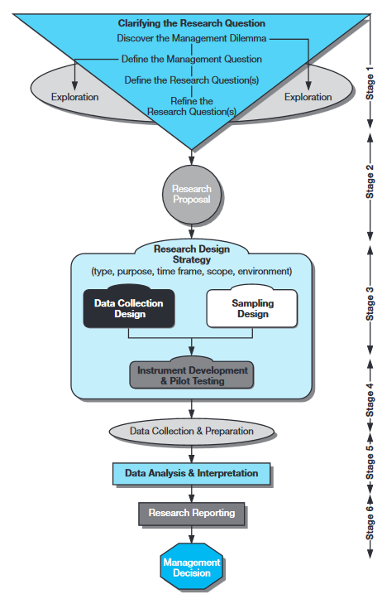

Slide 45
STEP I Formulating a Research Problem
STEP II Conceptualizing a Research Design
STEP III Constructing an Instrument for Data Collection
STEP IV Selecting a Sample
STEP V Writing a Research Proposal
STEP VI Collecting Data
STEP VII Processing and Displaying
STEP VIII Writing a Research Report

Slide 46
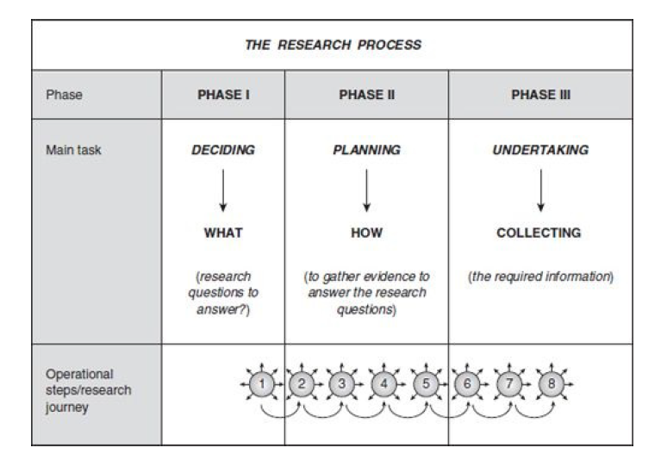

Slide 47
